Slide 1
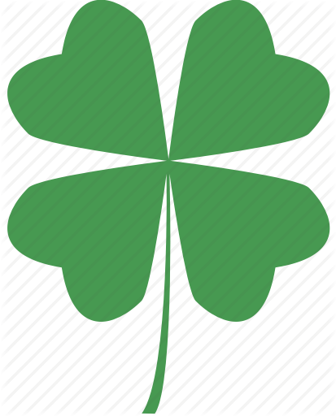
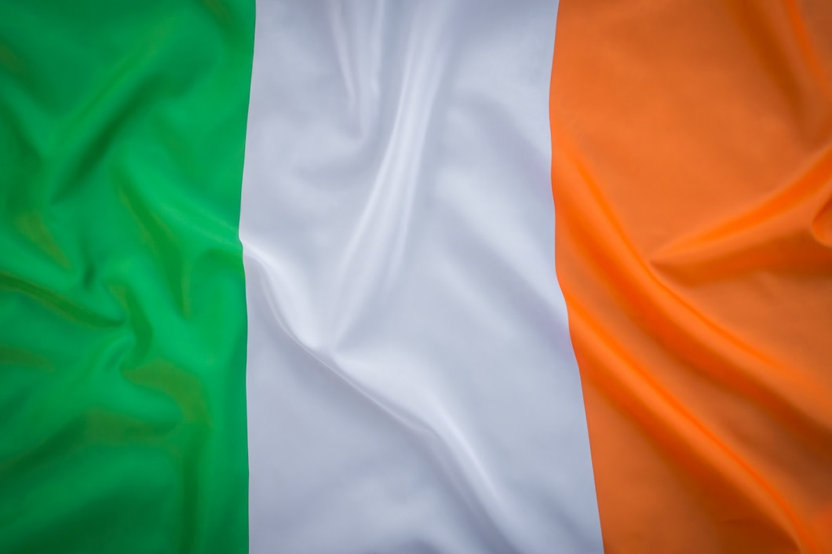
Republic of Ireland
Project of Artem Verbytsky, IPS-11

Slide 2
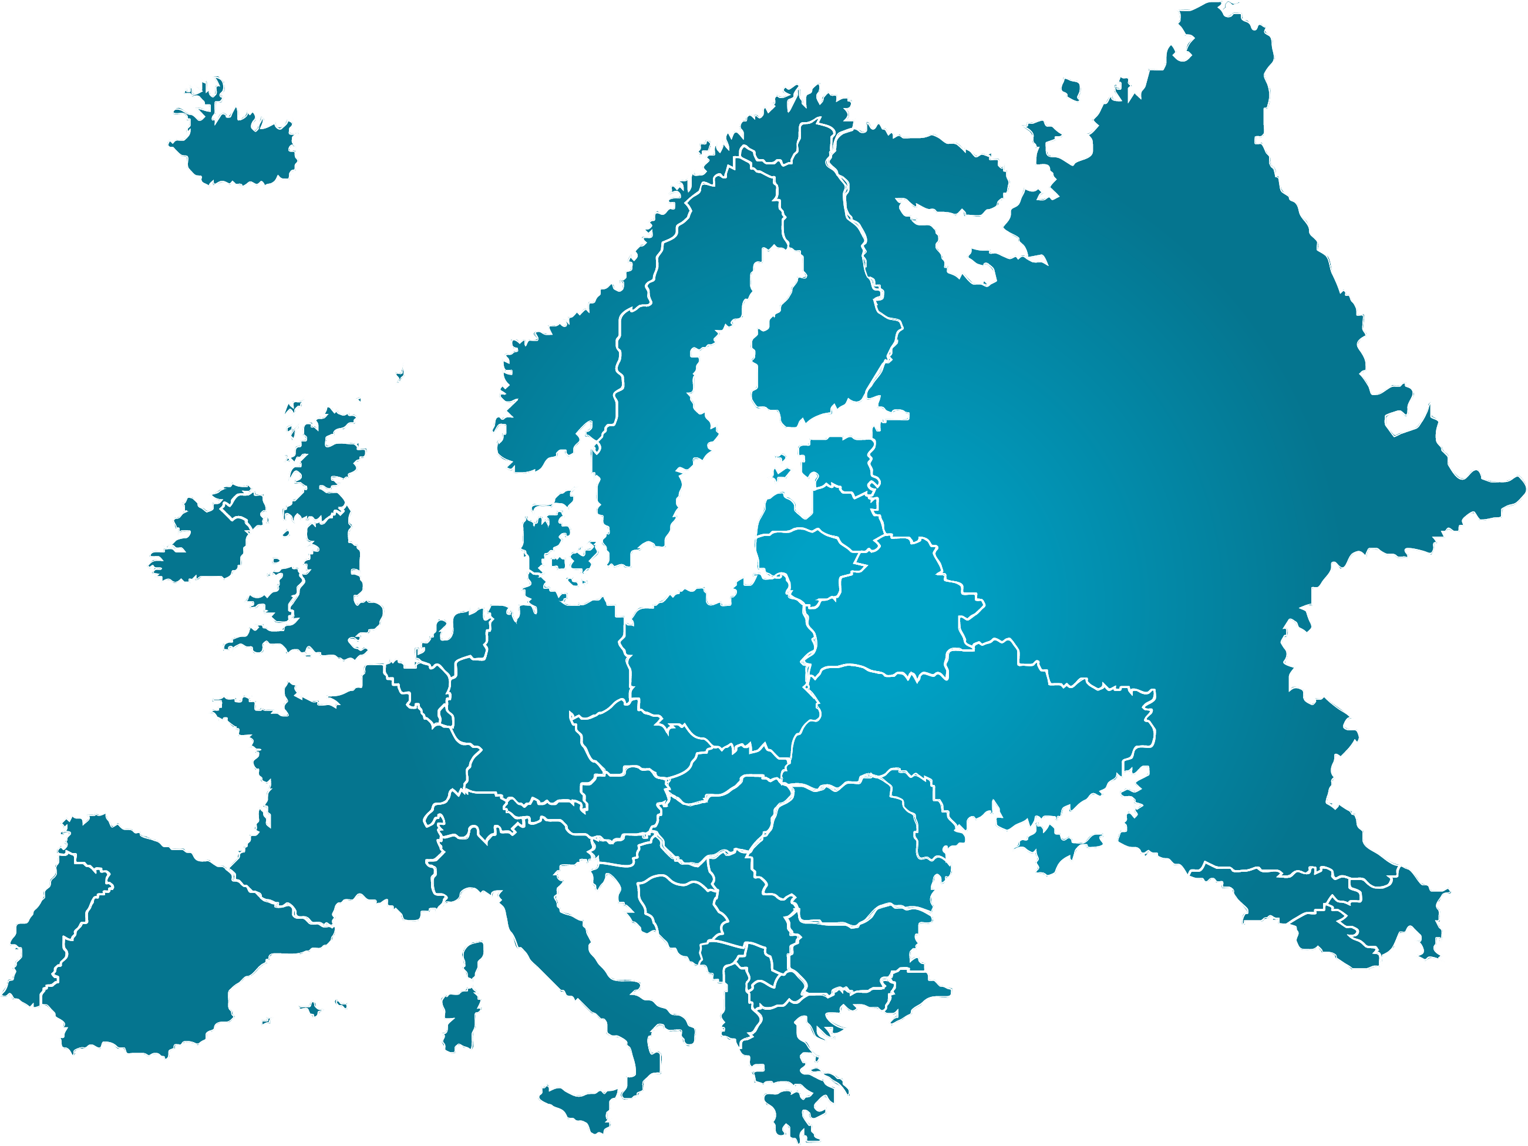
1
Ireland
Dublin

Slide 3
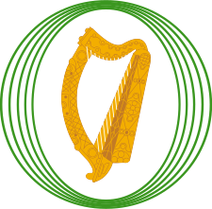
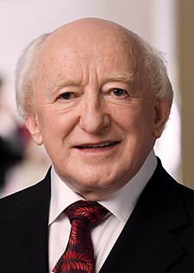
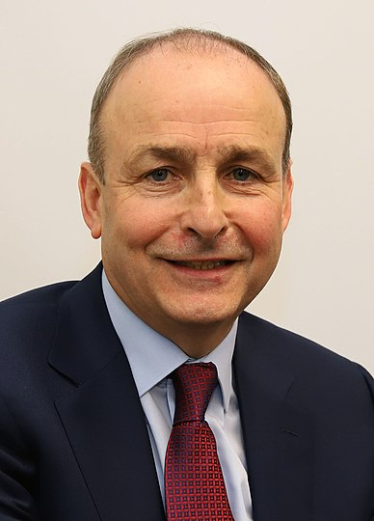
Oireachtas
2
President
Taoiseach
Dail Eireann (lower house)
Seanad Eireann (upper house)
Michael D. Higgins
Micheal Martin

Slide 4
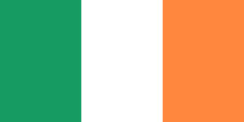
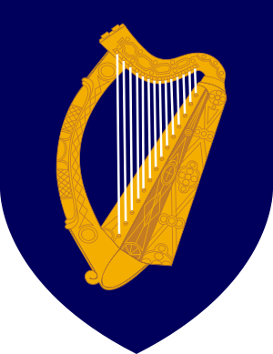
Ireland
3
Flag of Ireland
National anthem
of Ireland
"The Soldiers' Song“
Soldiers are we,
whose lives are pledged to Ireland,
Some have come
from a land beyond the wave,
Sworn to be free,
no more our ancient sireland,
Shall shelter the despot or the slave.
Tonight we man the «bearna baoil»,
In Erin's cause, come woe or weal,
’Mid cannon's roar and rifles’ peal,
We'll chant a soldier's song
Сoat of arms of Ireland

Slide 5
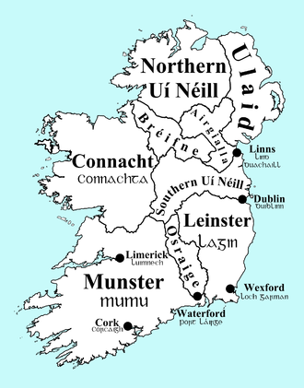
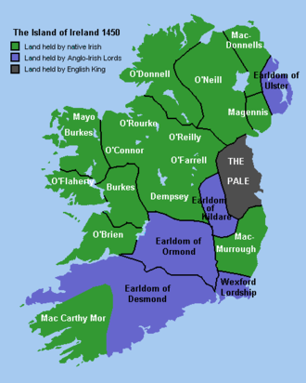
History of Ireland
4

Slide 6
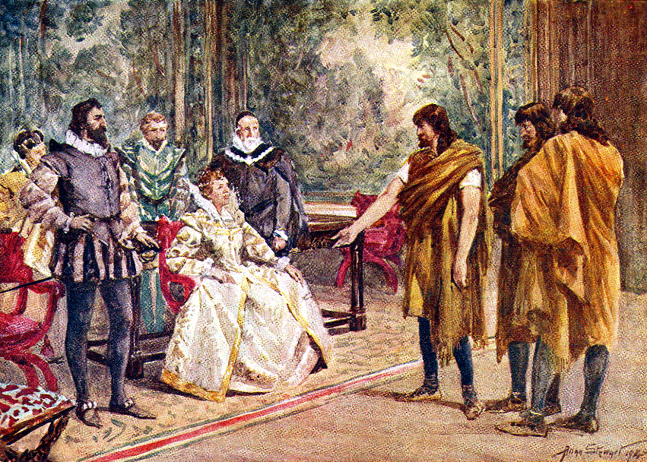
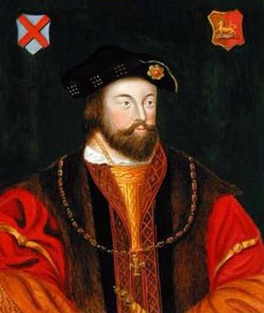
History of Ireland
5
Thomas FitzGerald
(Silken Thomas)
Shane O'Neill (Shane Proud)

Slide 7

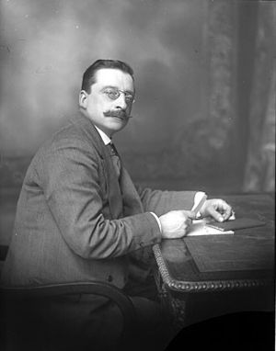
History of Ireland
6
The founder of party
Arthur Griffith
Sinn Fein (Irish: We are on our own) is a political organization in Ireland, founded in 1905 by the efforts of Arthur Griffith. In the early 1970s, a split led to the formation of the Sinn Fein party, active in Ireland and Northern Ireland to this day. Sinn Fein is a left-wing Irish republican party that advocates a united Ireland.

Slide 8
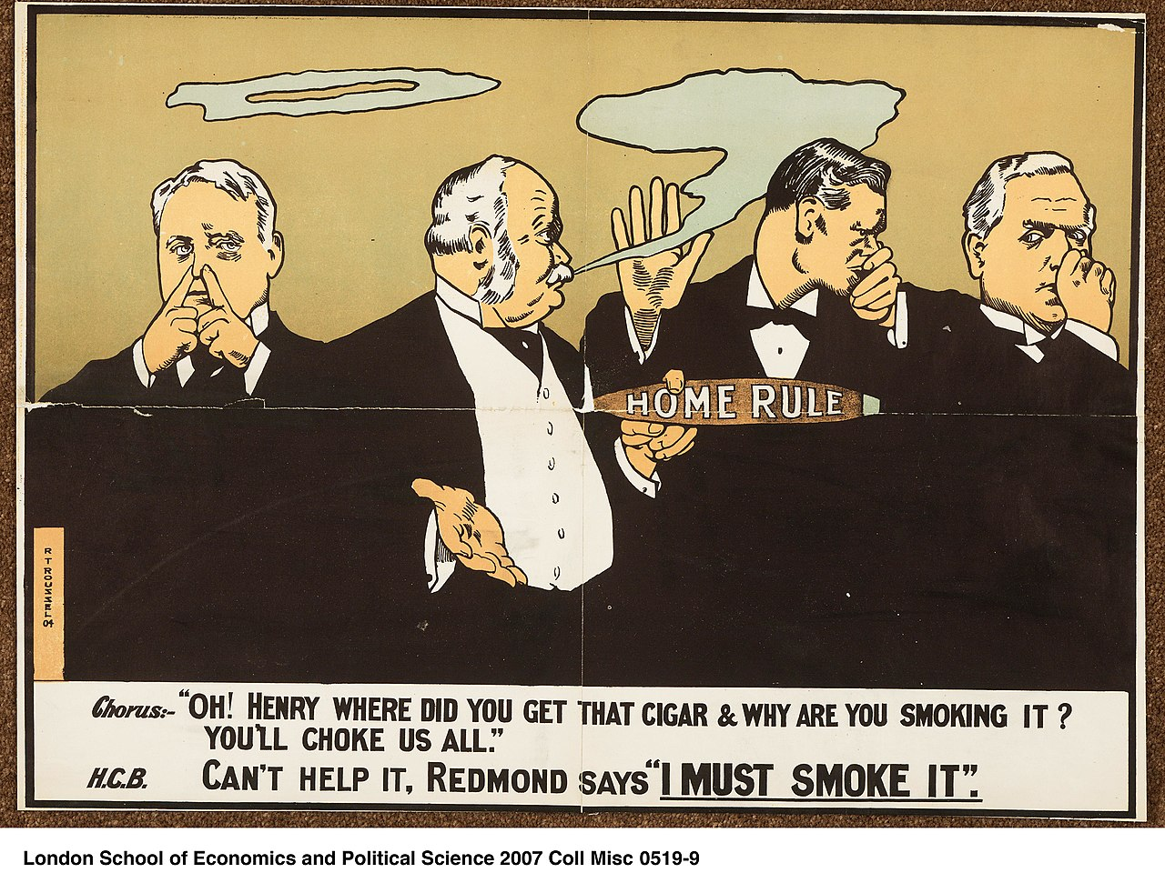
History of Ireland
7
Cartoon: British politicians have to endure
Home Rule cigar smoke Henry Campbell-Bannerman

Slide 9
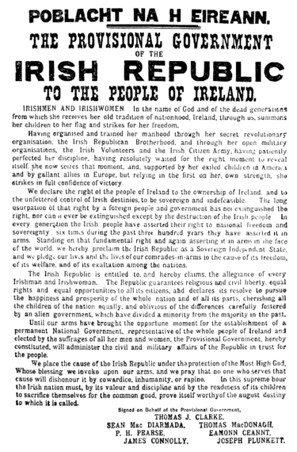
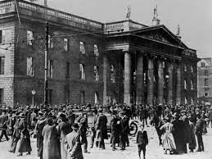
History of Ireland
8
The Easter Uprising (Irish: Éirí Amach na Cásca) is an uprising that took place on Easter 1916 (from April 24 to 30) in Ireland, in particular in the city of Dublin, for the independence of Ireland from Great Britain and the establishment of the Irish Republic. The uprising was crushed by British troops, its leaders and many participants were executed.
The Declaration of Independence
of the Irish Republic,
proclaimed by the rebels

Slide 10
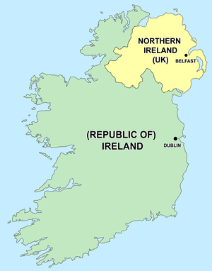




History of Ireland
9
The partition of Ireland in 1921

Slide 11
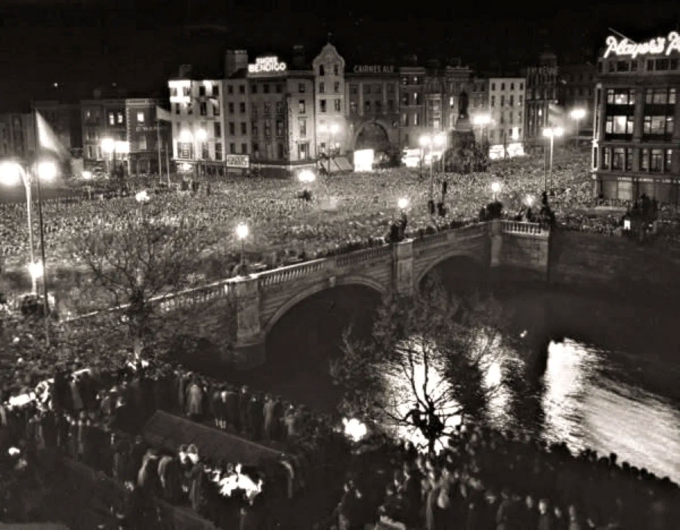
History of Ireland
10
On the same day, King George VI congratulated President O'Kelly by telegram: "I send you my sincere good wishes, mindful of the good neighborly ties which maintain the people of the Republic of Ireland in close association with the subjects of the United Kingdom. I gratefully remember the merits of the men and women of your country who generously aided our cause in the last war and made a notable contribution to our victories. I pray that blessings be with you today and in the future."
Celebrations on the occasion of the declaration of independence of Ireland, Dublin, April 18, 1949

Slide 12
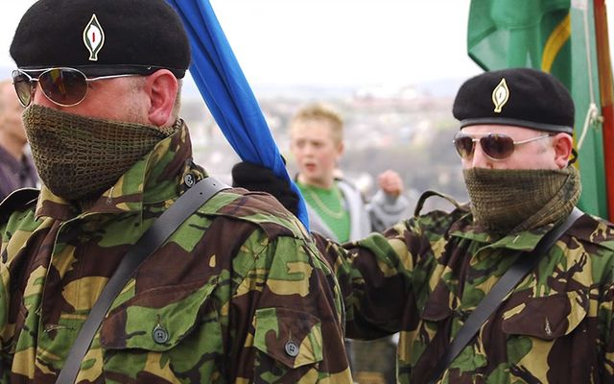
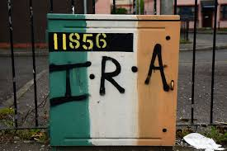
History of Ireland
11
The Irish Republican Army (IRA) is a paramilitary movement in Ireland in the 20th and 21st centuries that fought for the independence of the Republic of Ireland from Great Britain with the right to freely form its own government.

Slide 13
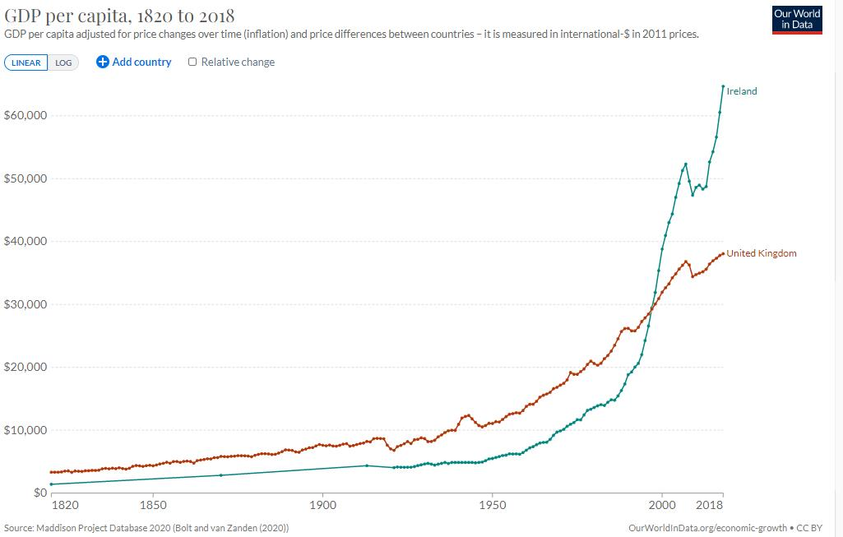
Economy of Ireland
12
Companies such as Intel, Microsoft and Google have invested in Ireland.
Ireland ranks ninth among the most economically free economies in the world according to the Index of Economic Freedom.
Since the early 1990s, the country has experienced unprecedented economic growth fueled by a surge in consumer spending, investment and construction, a phenomenon historically known as the "Celtic Tiger Period".

Slide 14
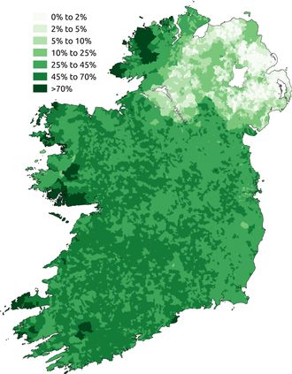
Language of Ireland
13
Irish (Standard Irish: Gaeilge), also known as Gaelic is a Goidelic language of the Insular Celtic branch of the Celtic language family, which is a part of the Indo-European language family. Irish is indigenous to the island of Irelandand was the population's first language until the 19th century, when English gradually became dominant, particularly in the last decades of the century. Irish is still spoken as a first language in a small number of areas of certain counties such as Cork, Donegal, Galway, and Kerry, as well as smaller areas of counties Mayo, Meath, and Waterford.
Proportion of respondents who said
they could speak Irish
in the Republic of Ireland
and Northern Ireland censuses of 2011

Slide 15
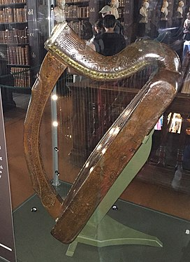
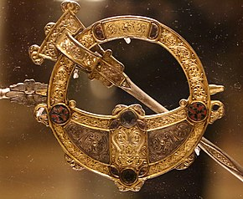
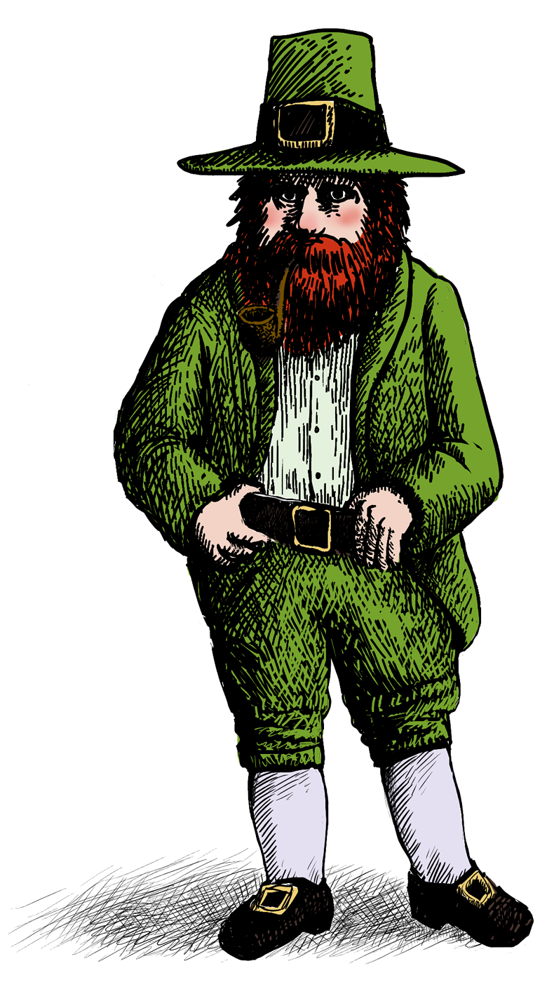
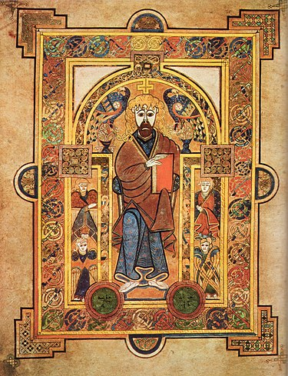
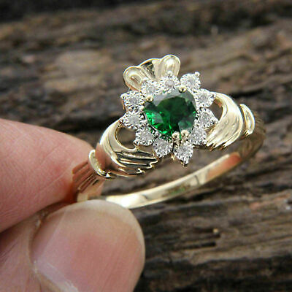
Symbol of Ireland
14
The Celtic harp
The Tara brooch
The leprechaun
The Book of Kells
The claddagh
engagement ring

Slide 16
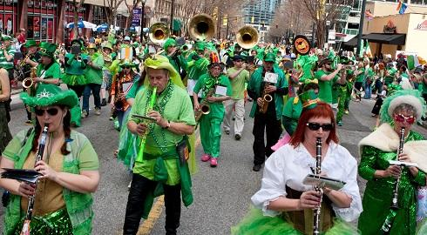
The main holiday of Ireland
15
St. Patrick's Day (Irish: Lá ’le Pádraig or Lá Fhéile Pádraig) is a cultural and religious Irish national holiday, which is celebrated every year on March 17, the day of the death of the heavenly patron saint of Ireland, St. Patrick.
Celebrations on St. Patrick's Day usually include parades and festivals, performing keili dances and wearing green clothes and decorating them with shamrocks.

Slide 17
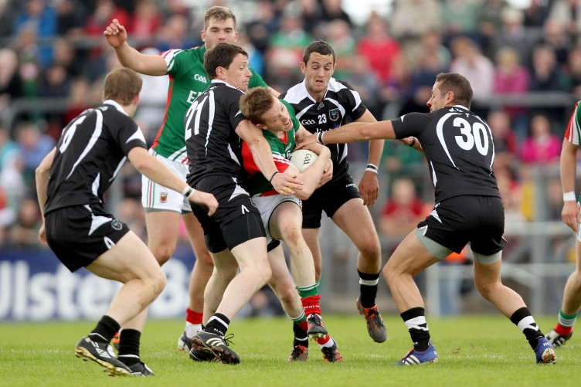
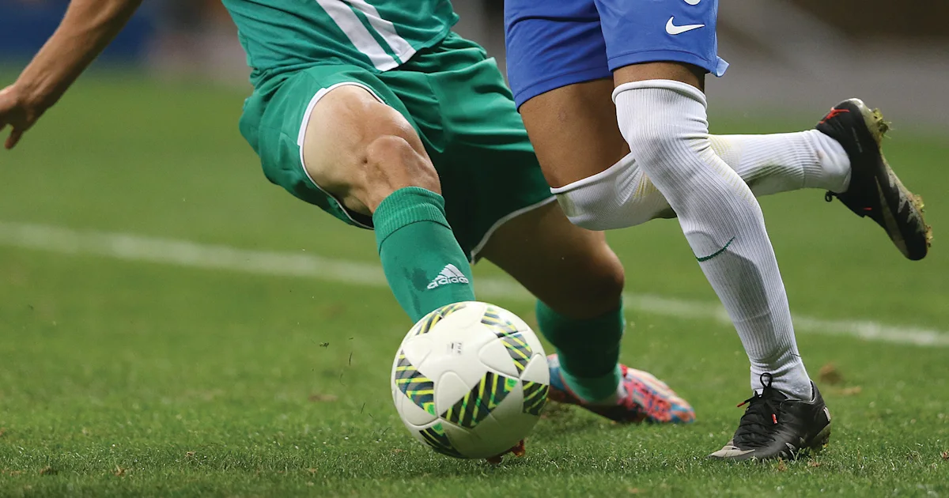
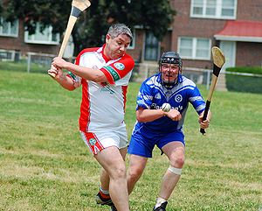
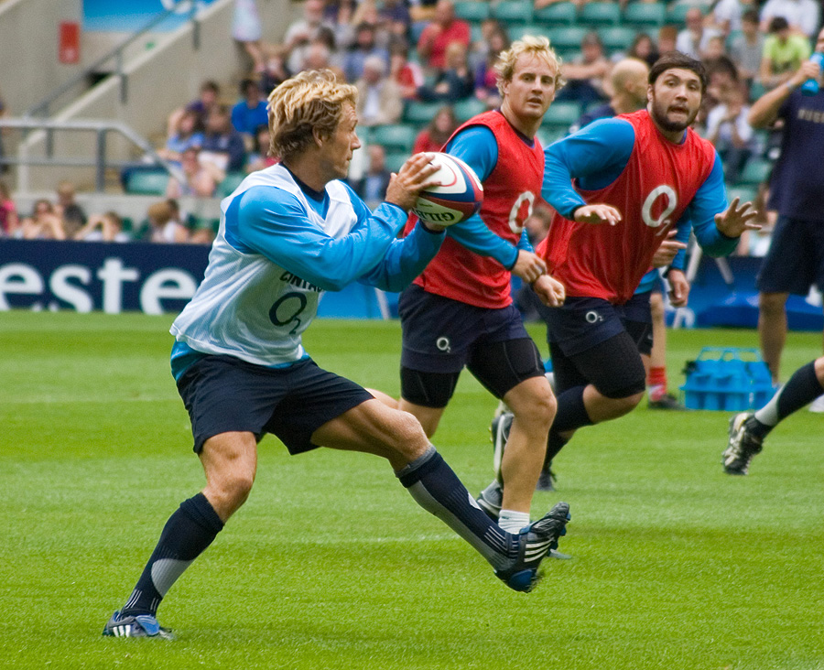
The most popular sports
in Ireland
16
Gaelic football
Football
Hurling
Rugby football

Slide 18
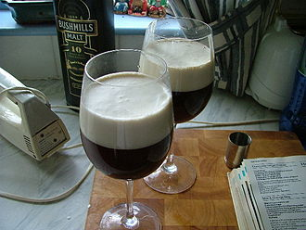
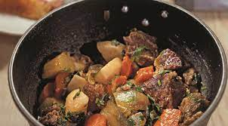
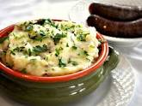
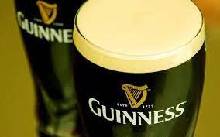
Irish cuisine
17
Irish coffee
Irish stew
Champ
Irish beer

Slide 19
Irish-Ukrainian relations
18
Ireland recognized Ukraine on December 31, 1991, diplomatic relations between the countries were established on April 1, 1992. Honorary consulates have been operating in Ukraine and Ireland since 2000, a Ukrainian embassy has been operating in Ireland since 2003, and an Irish embassy in Ukraine since 2021.
"I am grateful for understanding and for our relations, for a new page of relations. I believe that since the full-scale invasion of the russian federation into Ukraine, a new page has appeared in relations between Ukraine and Ireland. The atmosphere of these relations - powerful, warm, objective - is fully supported by our society," said Zelensky.

Slide 20
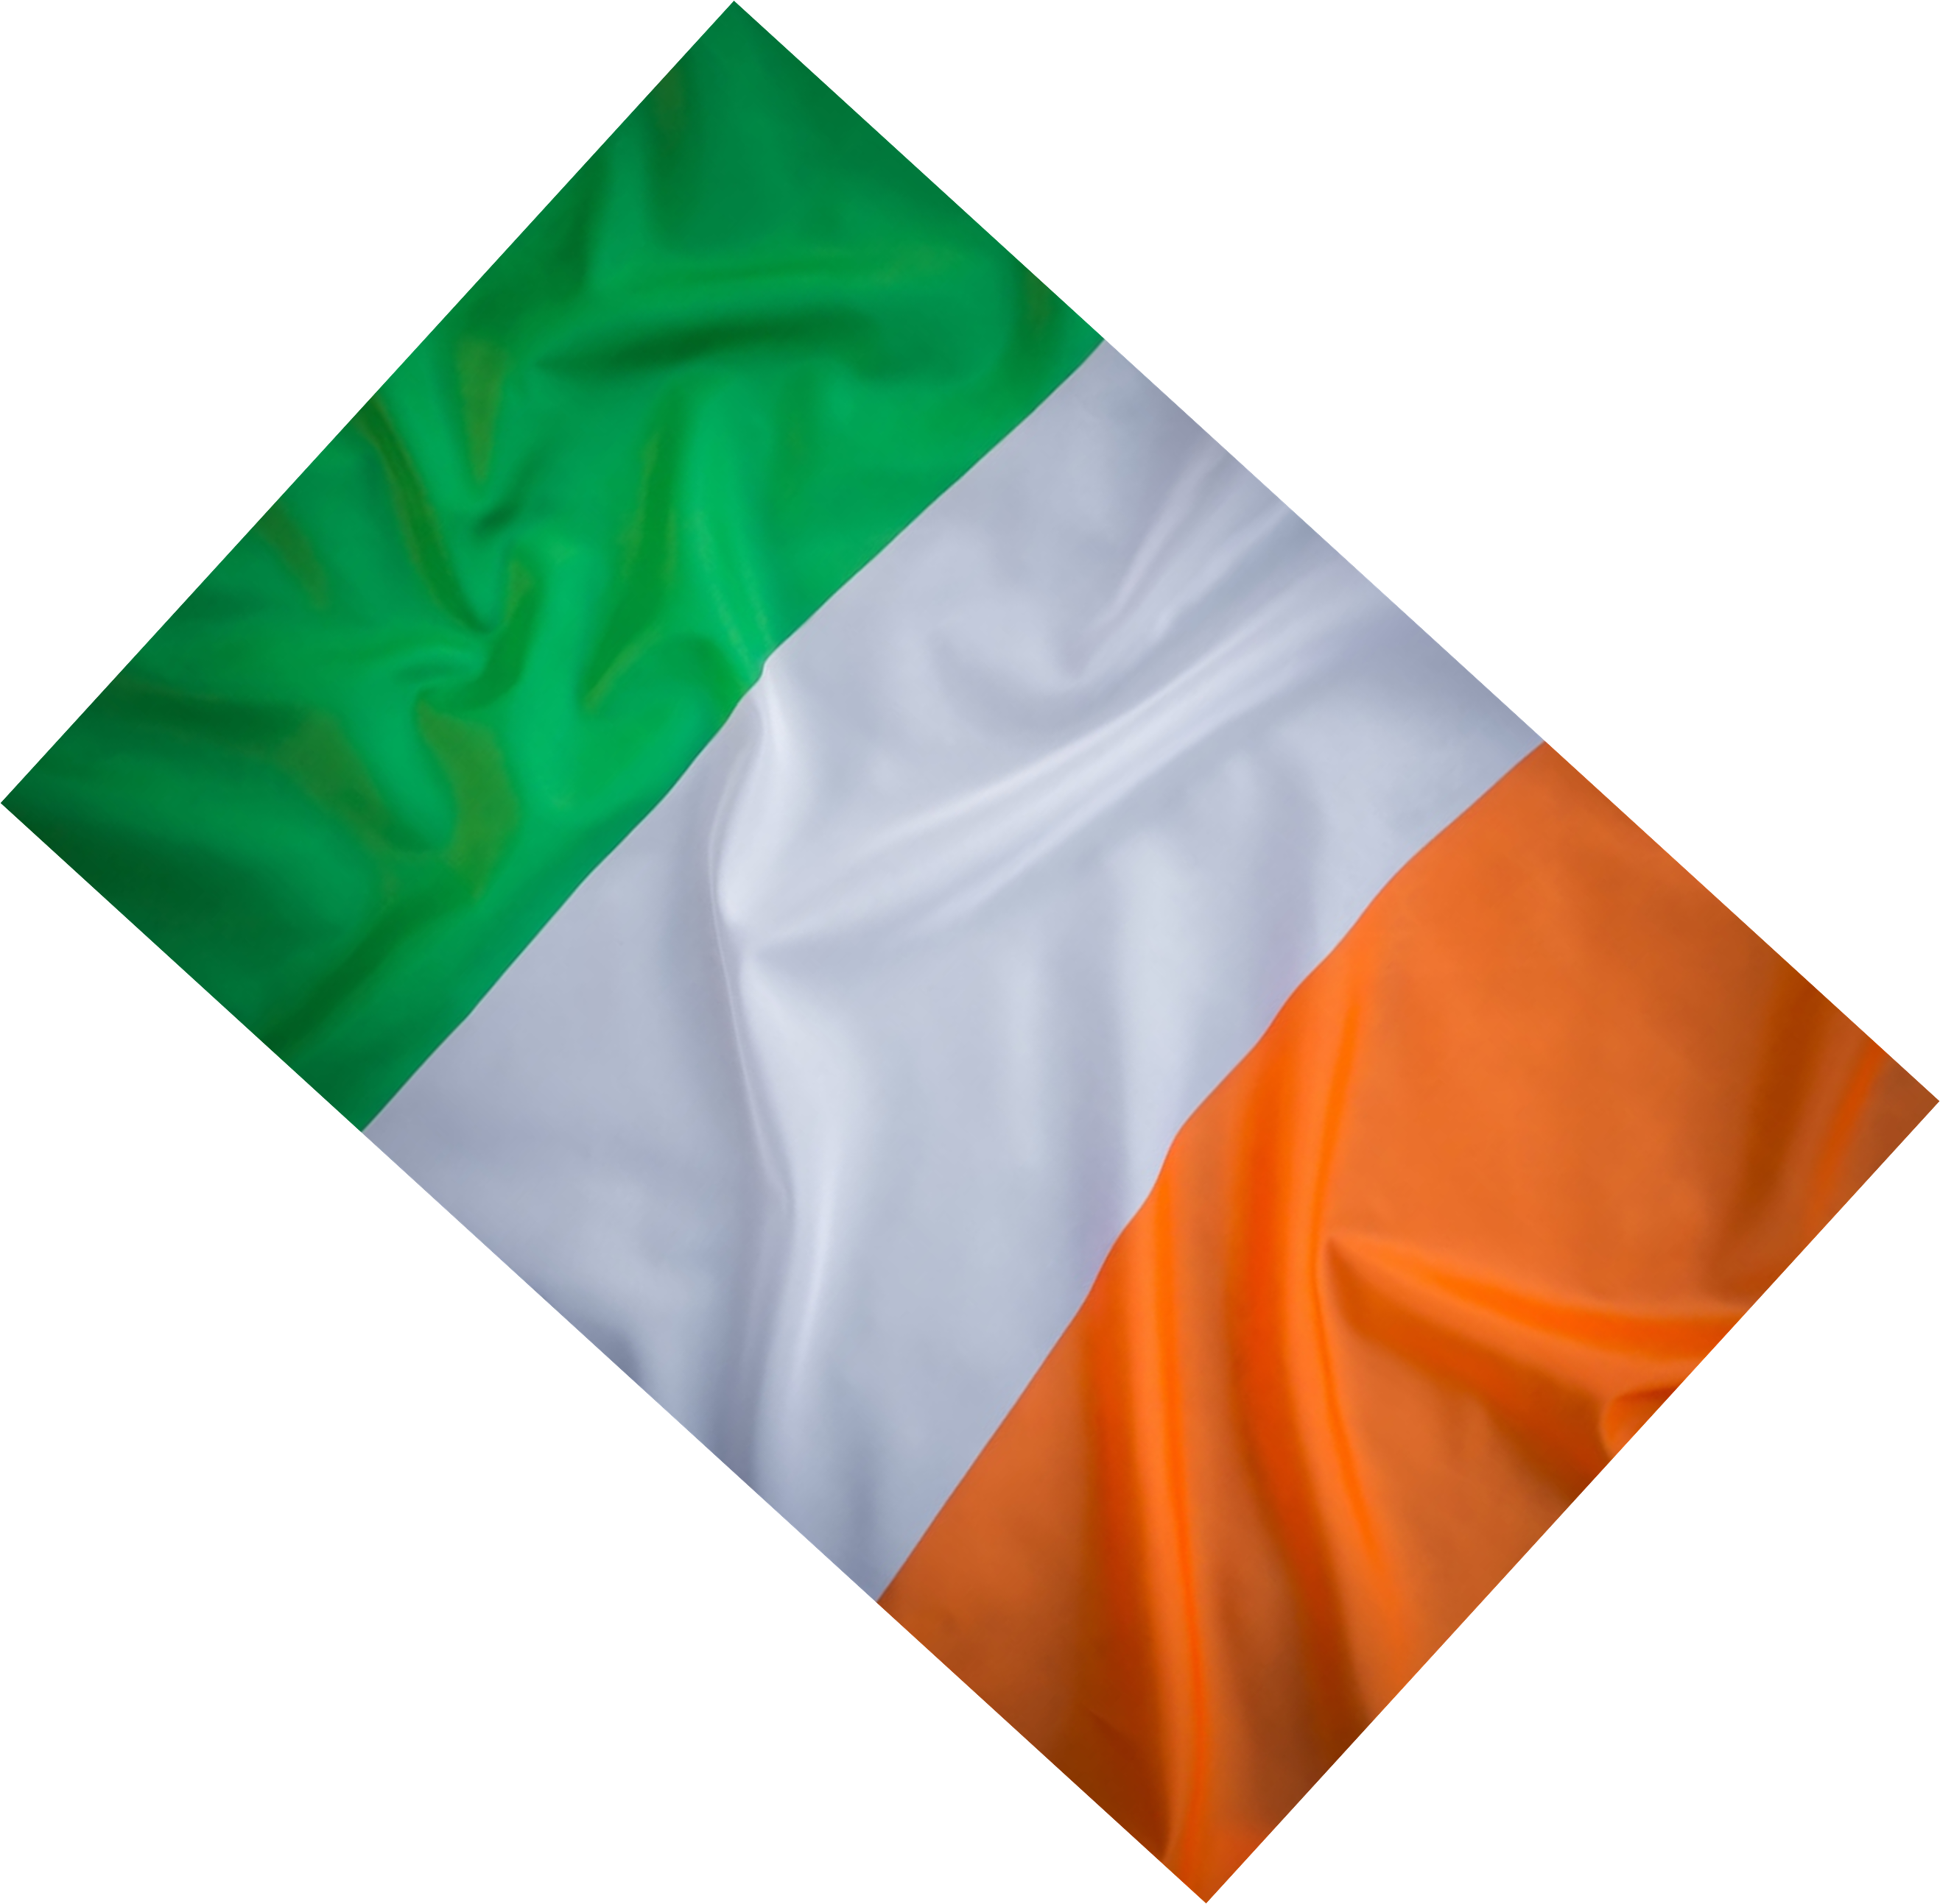
Thank you for attention

